Slide 1
Revisit Gender Differences in Taiwan's Academe:
The impact of SSCI & SCI
Chuing Prudence CHOU
Professor, Department of Education
National Cheng-Chi University, Taiwan
E-mail: iaezcpc2007@gmail.com
Website: http://www3.nccu.edu.tw/~iaezcpc/English%20index.htm

Slide 2
Question:
Education liberates, or oppresses?
How about for those who work in higher education institutes?
Professors who are supposed to liberate fall into victims of being oppressed?
Why?
The neo-liberal ideology, coupled with the global competition (such as university rankings), liberates or oppresses the academe?

Slide 3
Female faculty have been under-represented at universities, even women college students comprised over half of the total population in higher education.
Women have been segregated into lower ranks, part-time teaching positions, and less lucrative and 'female' fields.

Slide 4
Discrimination continues to exist among female faculty in hiring, reward, promotion and granting tenure.
Women have not been sponsored into the academic profession in the same ways as men have.

Slide 5
A research project on gender differences in Taiwan’s academe during the early 1990’s surveyed the status of women faculty in promotion and productivity.

Slide 6
It was found that female faculty (married and with children) were found to be at disadvantage during the 1990’s, in respect to professor promotion, high- ranking administrative positions, total income, and social networking.

Slide 7
The current paper intends to re-examine the current status of female faculty in Taiwan. After 20 years, with an emphasis on the introduction of new system, which demands faculty SSCI and SCI publication as one of the most important promotion criteria.

Slide 8
SSCI Syndrome in East Asia
The aspects of globalization, standardization and marketing effects, represent the profession's effectiveness and productivity.
University evaluation system use and misuse their own system, regardless if it is Arts or Sciences, measuring faculty in the with the SCI, SSCI, A&HCI and the number of articles from international periodical database.

Slide 9
Consequences of the so-called global academic standards as a whole
(1) enforces writing papers in English, other languages include journal articles or books published in local languages are no longer competitive.
(2) In order to increase the acceptance rate, international issues are set into the mainstream, relatively important domestic issues are neglected.

Slide 10
(3) Contribution to the overseas English written periodicals, Government and University Awards focus not entirely on the quality but the quantity.
(4) Form a quantified evaluation mechanism, widening the gap in publication and resource allocation between humanities/social sciences and Sciences.
(5) The negligence of cultural heritage and social context.

Slide 11
(6) The traditionally renowned dimensions, such as book publications and international recognitions, were cast aside with an even lower point value.

Slide 12
Since 2000-2010, Taiwan has been driven to pursue and target ‘world-class’ higher education standards, by introducing university evaluation and SSCI, SCI journal publication mechanism.
The MOE’s recent higher education reform efforts have led to a dramatic growth in SCI, SSCI, and EI publications

Slide 13
Women, traditionally, more concentrated on teaching and student guidance, are forced to join the traces of “journal publish, or perish.”

Slide 14
It is implied that the introduction of a new system rewarding, with SSCI and SCI publication as crucial performance criteria, has intensified competition for journal publication and, consequently, it has somewhat halted the growth and recognition of female faculty in Taiwan since early 2000’s.

Slide 15
Junior female faculty -in social sciences and humanities- tend to encounter more and more barriers when it comes to promotion and publication.

Slide 16
Rank Distribution of Females at National Cheng-Chi University (one of the top 12 leading research universities, renowned for social sciences and humanities, in Taiwan, 2010)
29% in professor rank,
41.4％ in associate professor,
40.6% of assistant professors,
and 61.5% in lecturers.

Slide 17
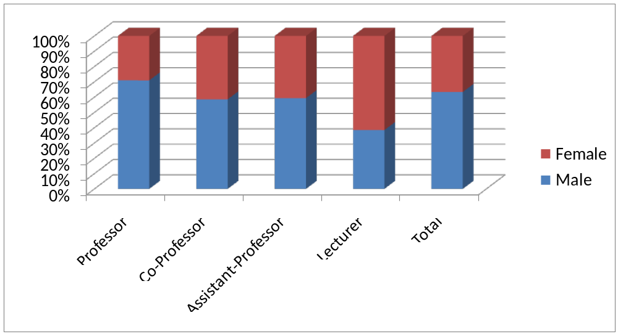
Case Study: A Public University in 2010

Slide 18
Females in high ranking administrative position
26.4％ in top position (ex. full-time executive),
33.3％ in deputy director position,
52.2％ in the third-tier administrative job in 2010.

Slide 19
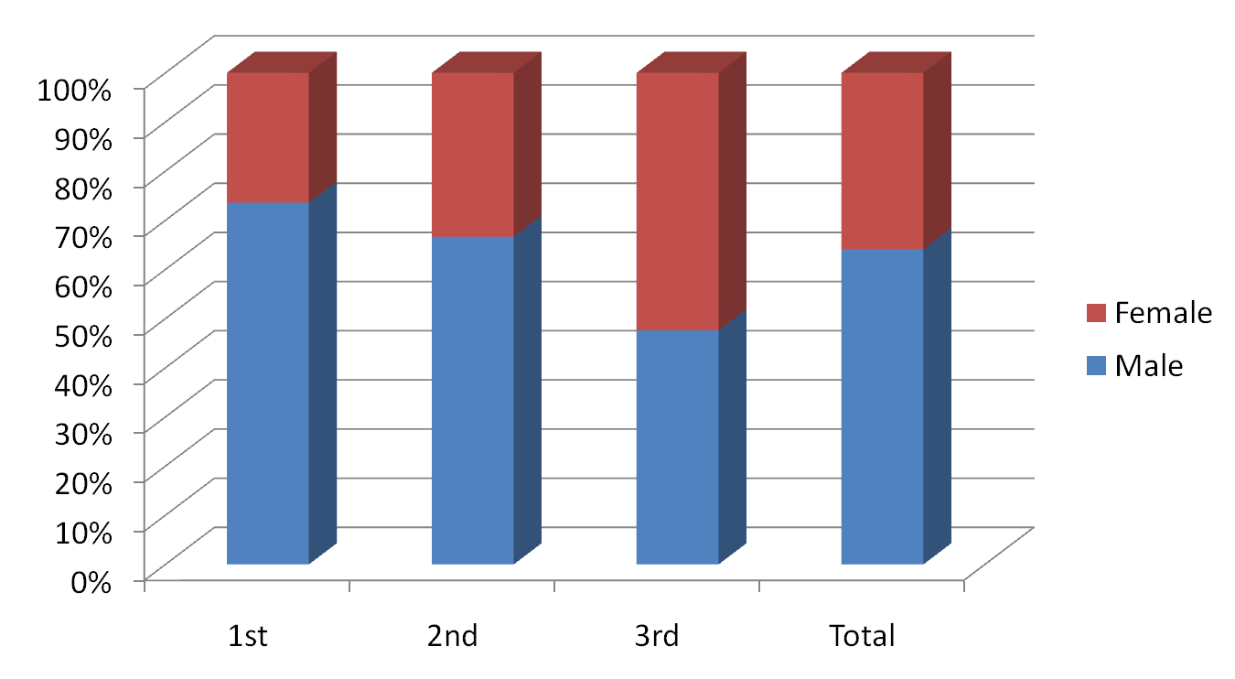
Administrator

Slide 20
An Increasing Gender Discrepancy under the new reward system
Many academic rewards within the university merit the number of SSCI and SCI publications, or performance related to SSCI and SCI.
Two most outstanding awards with higher salary scales and academic status depend on SSCI and SCI.

Slide 21
Firstly, in the Honorary Professor Award, women comprised 29.5％ in 2009, and decreased to 23.3％ in 2010.

Slide 22
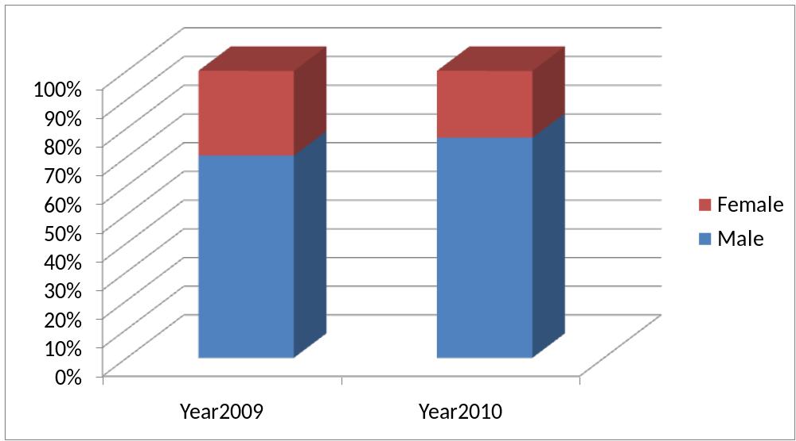
Honorary Professor Award, 2009 ＆2010

Slide 23
Another Distinguished Professor Award, women comprised 1/9 (12.5%) in 2009, and 1/8 (14.3％) in 2010.

Slide 24
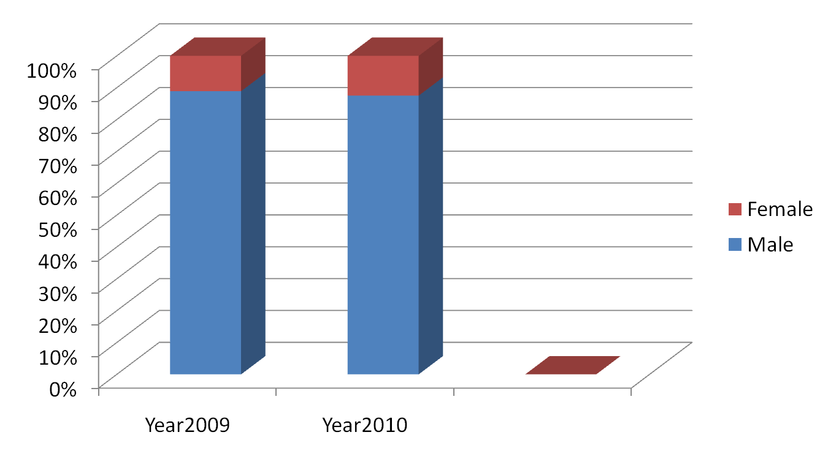
Distinguished Professor Award 2009 ＆2010

Slide 25
This discrepancy displays that males are prone to obtain additional grant money under the new university reward system.
Females from College of Arts and Humanity, Science, and International Affairs are less likely to receive these awards.

Slide 26
So, what’s next?
To liberate or to oppress?

Slide 27
Thank you for your attention.
E-mail: iaezcpc2007@gmail.com
Website: http://www3.nccu.edu.tw/~iaezcpc/English%20index.htm

